Slide 1
Accent Bias in International Higher Education International EFL students’ perspective
Dr Dozie Ugbaja
University of Hertfordshire, UK
Language and Prejudice Conference, Orebro, Sweden, November 2019

Slide 2
OUTLINE
1. Background Information
Accent
Bias
2. Research Context
3. International students as stakeholders in International Higher Education
4. International Student Categories based on English Language Usage
5. Research Focus/Research question
6. Intelligibility concept
7. Data
8. Results
9. Conclusions/Recommendations/Further Research

Slide 3
ACCENT
It is the means by which we make ourselves understood
and the yardstick by which others judge us
whether we like it or not.
Moyer (2013:8)

Slide 4
BIAS
Prejudice
Discrimination
From (negative) stereotypical views
Beukeboom and Burgers (2017)

Slide 5
RESEARCH CONTEXT
International Higher Education
De Wit (2011:242) observes that ‘the international dimension and the position of higher education in the global arena are given greater emphasis in international, national and institutional documents and mission statements than ever before.’
There is always an international strand to higher education these days
At least with an Equal Opportunities/Diversity claim or promotion
Even strides at the internationalisation of the curriculum

Slide 6
FOCUS/RESEARCH INTEREST Linguistic Communication/Accent Variation amongst major stakeholders in Higher Education

Slide 7
Who are the stakeholders?
Part of my research considers:
International students as stakeholders in International Higher Education

Slide 8
WHY?
A group of students with high stakes for the ‘International agenda’ of Higher Education
Accolades
Profit/Cash Cows

Slide 9
A look at international students’ categories based on English Language usage

Slide 10
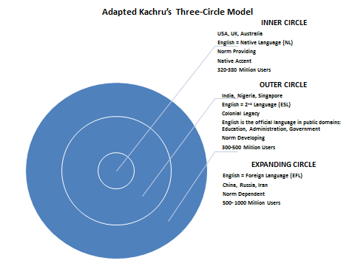
Global English varieties/Many Englishes Kachru(1985)

Slide 11
Language of International Higher Education
English is used as a lingua franca, in a Higher Education context within countries thought of as Native English Speaking (NS) countries
And for some international programmes in non-native speaking(NNS) countries

Slide 12
RESEARCH FOCUS International EFL students’ perception of the many varieties of English on the basis of accents

Slide 13
A look at the Teaching and Testing Standards Influence
Emphasis on Native Speaker recruitment for teaching purposes in EFL countries
Recruitment reality for EFL students coming to study on pre-sessional programmes
TESTS-IELTS/TOEFL testing standards

Slide 14
A Question for Consideration
To what extent is the NS teaching and testing system a cause of accent bias?

Slide 15
Research Questions To what extent is there the existence of accent bias problem in the learning and teaching experiences of international EFL students?
What are the perspectives of EFL or Expanding Circle students on being taught by (nationally selected) WE/NNS teachers with peculiar varieties that are country-specific and particularly distinct from those of the NS?

Slide 16
To answer the question: INTELLIGIBILITY TESTS WERE INTRODUCED

Slide 17
WHAT IS INTELLIGIBILITY?
Being clear and easy to understand
The extent to which a speaker’s message is actually understood by a listener.
The ability of a listener to recognize individual words or utterances.
Comprehensibility: a listener’s ability to understand the meaning of the words or utterance based on context.

Slide 18
DATA
INTELLIGIBILITY TEST Based on TWO OUTER CIRCLE (NNS) VARIETIES
WEST AFRICAN AND SOUTH ASIAN (COUNTRY SPECIFIC) VARIETIES

Slide 19
DATA COLLECTION
Replicated IELTS Test- with educated West African and South Asian speakers
Perceptions questionnaire
3. Focus group discussions
Administered in two institutions in the UK and USA to EFL (Expanding Circle) Students

Slide 20
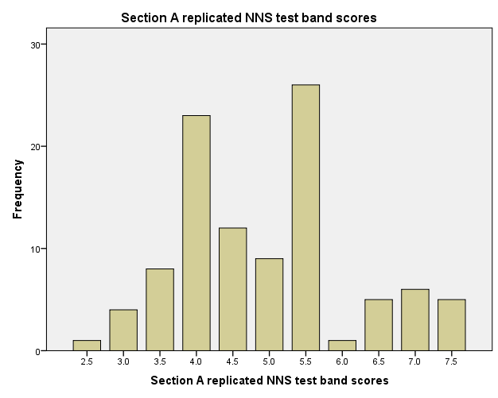
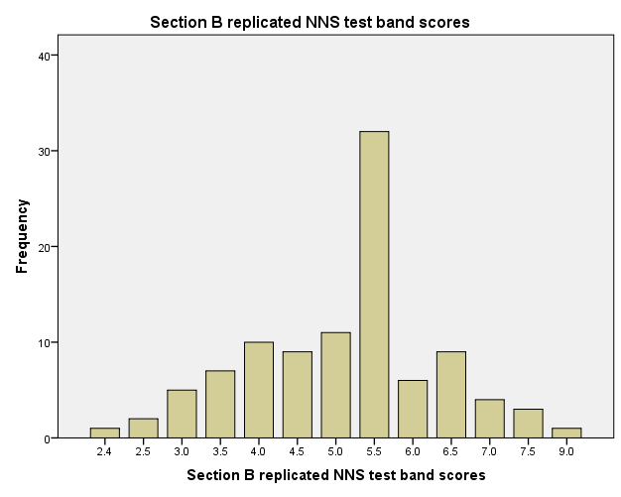
BAND SCORE RESULTS
SOUTH ASIAN VARIETY
WEST AFRICAN VARIETY

Slide 21
FREQUENCIES
SOUTH ASIAN
WEST AFRICAN
Statistics
 |  | Original SE based IELTS band scores | Section A (Indian) Replicated NNS test band scores
N | Valid | 100 | 100
 | Missing | 0 | 0
Mean |  | 5.500 | 4.945
Median |  | 5.500 | 5.000
Mode |  | 5.5 | 5.5
Std. Deviation |  | .0000 | 1.1890
Variance |  | .000 | 1.414
Range |  | .0 | 5.0
Minimum |  | 5.5 | 2.5
Maximum |  | 5.5 | 7.5
Sum |  | 550.0 | 494.5
Statistics
 |  | Original SE based IELTS band scores | Section B (Nigerian) Replicated NNS test band scores
N | Valid | 100 | 100
 | Missing | 0 | 0
Mean |  | 5.500 | 5.124
Median |  | 5.500 | 5.500
Mode |  | 5.5 | 5.5
Std. Deviation |  | .0000 | 1.2339
Variance |  | .000 | 1.522
Range |  | .0 | 6.6
Minimum |  | 5.5 | 2.4
Maximum |  | 5.5 | 9.0
Sum |  | 550.0 | 512.4

Slide 22
The speaker of section A was clear and easy to understand

Slide 23
I will understand the speaker in section A if he/she is one of my teachers on my major course of study.

Slide 24
I disliked the accent of the first speaker in section A of the test. (Reverse order scoring)

Slide 25
The speaker of section B was clear and easy to understand

Slide 26
I will understand the speaker in section B if he/she is one of my teachers on my major course of study.

Slide 27
I disliked the accent of the second speaker in section B of the test. (Reverse order scoring)

Slide 28
FINDINGS-Focus Group Discussions
Similar to findings of perception questionnaire

Slide 29
SELECTION OF EXTRACT RESPONSES TO QUESTION 1- Clarity Focus Group 2, US: UAE 1 - 'No I don't think so, you need to know English well so you can understand it. Other people who don't know English very well won't be able to understand what he is saying, you need to focus and have all your mind with him so it wasn't easy to understand.’ UAE 3 - '…I understand a little bit from it. UAE 2 - '…he has his own way to talk' Saudi 1 - 'I think that the native language for this person affects his accent so he speaks English, some letters he can't pronounce them well…’

Slide 30
Focus Group 3, US: Thai 1 - ‘It was very difficult for me to understand. The pronounce was really bad’ Chinese 1 - ‘I couldn’t understand almost everything’ Saudi 1 - ‘It was not easy because the accent’ Kuwait 1- ‘I couldn’t follow what he said and the pronunciation is not good’

Slide 31
SELECTION OF EXTRACT RESPONSES TO QUESTION 1- Clarity
Focus Group 1, UK:
Korean 1 - ‘I disagree because he has no accent and some words he pronounce wrong.’
Turkish 2 - ‘The pronunciation is really different than with British people’
Chinese 4 - ‘and his tongue always lolololololo like this’
(All participants laugh as if to concur with Chinese 4)
Focus Group 2, UK:
Chinese 1 - ‘I don’t agree, it’s quite a bit quick so hard to listen’
Korean 2 - ‘and his pronunciation is not clearly, it’s not clear to understand.

Slide 32
SELECTION OF EXTRACT RESPONSES TO QUESTION 1
Focus Group 3, UK:
All Participants Chorused - ‘No’
Chinese 2 - ‘I don't agree because section A, the accent is not clear’
Chinese 3 - ‘I can understand a little’
Qatari 2- 'I put em disagree because he pronounce some words I cannot understand'
Qatari 2- 'I put em disagree because he pronounce some words I cannot understand'
Brazilian 2- 'I strongly disagree because I didn't get almost the, I didn't get any information about the lecture so I feel lost in the lecture'
Saudi 2- 'I agree with Brazil 2 because I couldn't get a specific information so I got lost'
Qatari 2- 'I am agree with Saudi 2… it was difficult to understand’.

Slide 33
Focus Group 2, UK: Iranian 3 - ‘I am strongly disagree. I couldn't understand very well because er, she speak part by part like this. I thought she is Chinese but the friends told me no she is not Chinese maybe another country... she speaks same as Chinese. African I told’ Chinese 1 – ‘…the girl is using the monotone just and like the volume is like reading something’

Slide 34
Do you think you will understand the speaker in section A if he/she is one of your teachers on your major course of study?
Chinese 3 – ‘strongly disagree’
Chinese 5 - ‘I think I will change university, I will change my major or university’.
UAE 1 - 'I would definitely change the teacher because it's just annoying me…
UAE 1- '…I wouldn't understand him at the first. I will suffer maybe at the first…’
Saudi 1 - 'I will say that I will understand but I prefer the Native Speaker'
Omani 1 - 'I don't think that I will like to sit in his session. I will like try to find another session that has like US accent...If I have chance to like change with another teacher, I will change'

Slide 35
UAE 3 - 'I think as UAE 1 said, in the first I will suffer with this accent, because I cannot understand...’ Saudi 3 - '… if I can change it, I will change because it's so difficult to understand section A. Saudi 2 - '… I think if it's my teacher in my major, I can't understand him, I will not pass the course. Thai 1 - 'I think I cannot understand if she is not native speaker so why I come here? because I want to study with a teacher native speaker'

Slide 36
Do you think you will understand the speaker in section B if he/she is one of your teachers on your major course of study?
Iraqi 2- 'I strongly disagree because I come here to study… I want to focus on my major, I want to understand, not to take another accent or something’.
Iraqi 1 - 'It's big problem, I think I will go out to some tutoring maybe to help me understand'
Qatari 2 - 'Absolutely …it will be hard to live with that'
Qatari 1 - 'I will kill myself'

Slide 37
UAE 3 - '… the professor or the doctor in my major, I think her or his accent will be better than this, this accent’ Chinese 1 - ‘drop’ Saudi 1 - '…that means I have complete course to learn their accents so maybe one or two months...' Thai 1 - 'Maybe I will take some course first for prepare and adapt her accent. Maybe five months. If it's not good then I come back home’.

Slide 38
Conclusions
Accent bias exists even when intelligibility is achieved
Acceptance and accommodation still appears far-fetched especially from international EFL students.
Teaching and Testing systems strengthen the prejudice problem
International EFL students cannot take the blame
Thrown into the fire after their English language learning and testing process.
Findings cannot be generalised at the moment- Just for two accent varieties, from only two international institutions in the UK and USA

Slide 39
RECOMMENDATIONS
More intelligibility tests (including other varieties in order not to marginalise certain accents on the basis of negative stereotypes and bias).
Intelligibility awareness/promotion
PRE-EXPOSURE for adaptability and accommodation not necessarily acceptance.

Slide 40
Thank you for listening!

