Slide 1
Results and Discussion
So what have we really been doing?

Slide 2
Raising Awareness about Stereotyping!
Language is one of the major factors that we evaluate when we meet others, and it has long been demonstrated that individuals are judged in terms of intellect and other character traits on the basis of their language output.
We also adapt our own language to fit underlying norms and preconceived social stereotypes when we communicate with others.
Further, we help to shape individuals through the way we treat them linguistically. Social identity expressed through language is consequently something that is renegotiated during every meeting between humans.
The exercise you have just taken part in was designed to raise awareness about these issues.
Developed in the projects RAVE and C-RAVE: https://www.stereotyping.se/
Notes:
We are obviously grateful if you mention the project context.

Slide 3
Stereotyping
Stereotyping is a reductive cognitive phenomenon in the categorization of groups of people. A quick and efficient shorthand, but which ignores individuality and variation.
Language is a key element in this process. According to Collins & Clement (2012: 377), “language can be conceptualized as “a lens that directs and distorts cognition”.
Not only does stereotyping, based on various social categories such as gender, age, social class, ethnicity, sexuality or regional affiliation, serve to simplify how people perceive and process information about individuals (Talbot, 2003: 468), it also builds up expectations on how they are supposed to act. “People can choose to ignore such expectations, but they still have to relate to them in their interactions with others” (Talbot, 2003: 472).

Slide 4
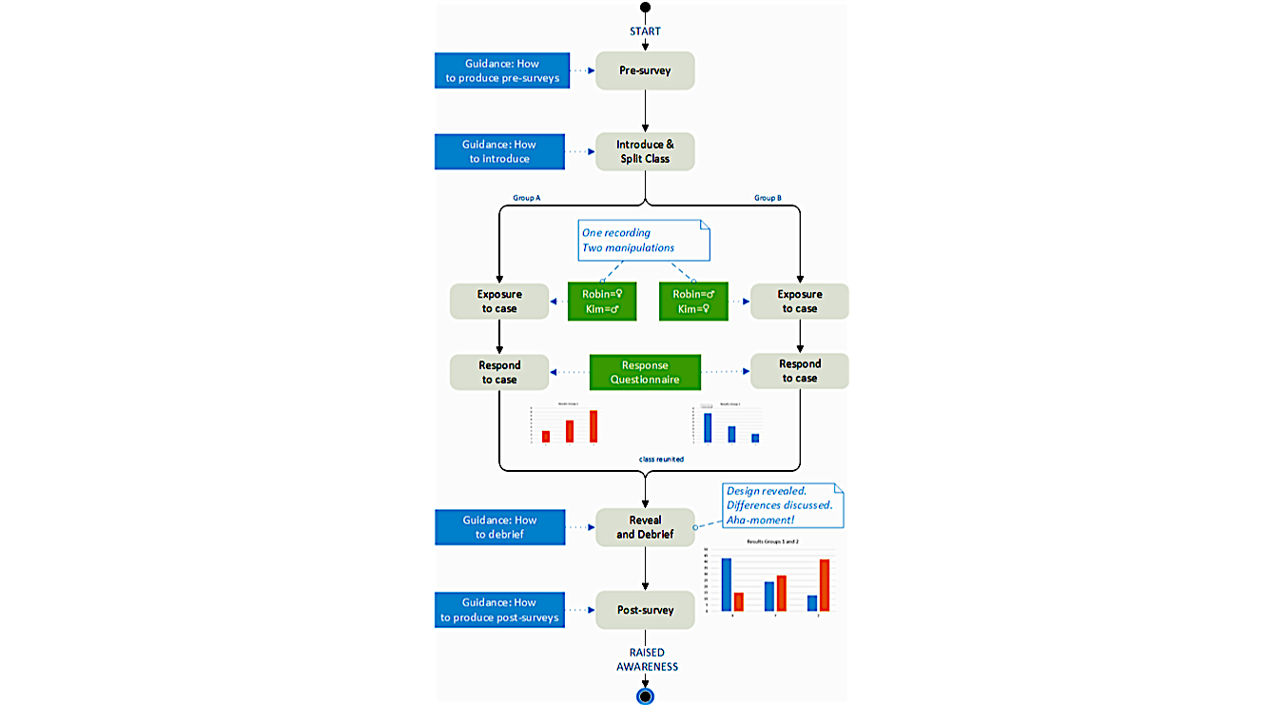
Method

Slide 5
Matched-Guise
Same text, different versions.
https://youtu.be/zCSRPoiQAz0
https://youtu.be/WTVIWSCeoss

Slide 6
Recap of the context of the survey
After you had listened to a conversation between Mats D and Robin Franklyn, we asked you to rate RF with regard to the following traits (1 – 7, where 1 disagree completely and 7 agree completely):
RF interrupts the other speaker a lot.
RF signals interest in what the other person is saying.
RF argues in a forceful way
RF takes up a lot of space in the conversation
RF contradicts the other person a lot
RF comes across as sympathetic
RF comes across as knowledgeable.
RF comes across as supportive
RF comes across as trustworthy
RF comes across as confident

Slide 7
Your results – language impressions (n=17)

Slide 8
Your results – impressions of persons

Slide 9
In summary

Slide 10
Your gender stereotypes of linguistic behaviour

Slide 11
Örebro summary 2017-2019 (n=109)

Slide 12
In summary
It seems that we notice behaviour that we stereotypically see as feminine when we think we are listening to a woman and vice versa.
So stereotyping can be envisaged as a selective filter which directs our attention towards aspects that confirm our beliefs (and ignore aspects that question our beliefs).

Slide 13
International studies
How do the results compare with other cultural contexts?

Slide 14
Results from the Seychelles

Slide 15
Swedish responses. (7 point Likert scale: 1 disagree completely; 7 = agree completely)

Slide 16
Seychelles responses. (7 point Likert scale: 1 disagree completely; 7 = agree completely)

Slide 17
In summary Seychelles

Slide 18
Why?

Slide 19
Re-adjusted summary Seychelles

Slide 20
Questions to ponder over
What are we looking at here?
How can we explain what we are seeing?
Did the results surprise you or were they expected?
How do expectations about gender affect our judgement about RF:s personality and behaviour?
When RF is presented as a man/women – what do we see?
How can we best explain the difference between the results here and the international/Seychelles participants?

Slide 21
Discuss in groups
Which results do you think were most striking?
Were you surprised by these results? Why?
How do we explain these results?
What can trends such as the ones we have seen lead to in an educational context?
What might be the consequences of such trends from a societal perspective?
In what way do you think that awareness of stereotype effects can help you in your professional practice?
How can you better equip yourself as a teacher to respond to students’ and colleagues' stereotyping tendencies in the workplace?

