Slide 1
Debriefing open guise experiment xxx. Results and Discussion

Slide 2
Raising Awareness about Stereotyping!
Language is one of the major factors that we evaluate when we meet others, and it has long been demonstrated that individuals are judged in terms of intellect and other character traits on the basis of their language output.
We also adapt our own language to fit underlying norms and preconceived social stereotypes when we communicate with others.
Further, we help to shape individuals through the way we treat them linguistically. Social identity expressed through language is consequently something that is renegotiated during every meeting between humans.
The exercise you have just taken part in was designed to raise awareness about these issues.
Developed in the projects RAVE and C-RAVE: https://www.stereotyping.se/
Notes:
We are obviously grateful if you mention the project context.

Slide 3
Stereotyping
Stereotyping is a reductive cognitive phenomenon in the categorization of groups of people. A quick and efficient shorthand, but which ignores individuality and variation.
Language is a key element in this process. According to Collins & Clement (2012: 377), “language can be conceptualized as “a lens that directs and distorts cognition”.
Not only does stereotyping, based on various social categories such as gender, age, social class, ethnicity, sexuality or regional affiliation, serve to simplify how people perceive and process information about individuals (Talbot, 2003: 468), it also builds up expectations on how they are supposed to act. “People can choose to ignore such expectations, but they still have to relate to them in their interactions with others” (Talbot, 2003: 472).
Reversed linguistic stereotyping: “attributions of a speaker’s group membership trigger distorted evaluations of that person’s speech” (Kang and Rubin 2009: 441). This can be more or less salient.

Slide 4
Script
Robin: I assume this sort of stuff is backed up on the secure internal server, right?
Kim: Eeerm. I’m.. I’m not sure.
Robin: What do you mean “you’re not sure”?!
Kim: Well, eerm, I mean John and Beth are the ones that are involved with security and back-ups so …
Robin: So if they weren’t here we’d be totally lost, right… and you wouldn’t have a clue!?
Kim: I’d most probably look up the formal internal routines for this sort of thing… that don’t exist…
Robin: Well… Jesus! You’re telling me you don’t know, or worse, that there are no routines – this is a critical issue, don’t you think? If we lose this type of stuff, or, just imagine if it ends up in the wrong hands! We are talking major disaster! Things can’t be run like this!
Kim: No, I guess not. Sorry, I’ll try to look into it.
Robin: Don’t try Kim! Just do it! Give me an overview of the routines when you’re done.

Slide 5
Recordings
Robin male- Kim female: https://youtu.be/6yTfZ9rk1Wc
Robin female- Kim male: https://youtu.be/g3qk_TDb0cQ

Slide 6
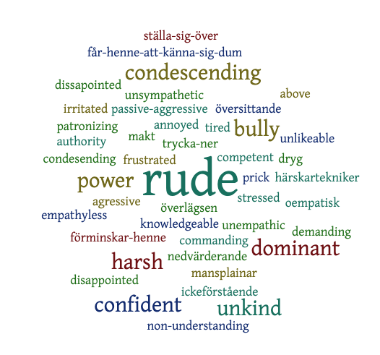
Adjectives used in decriptions of Robin – male (N=xx)

Slide 7
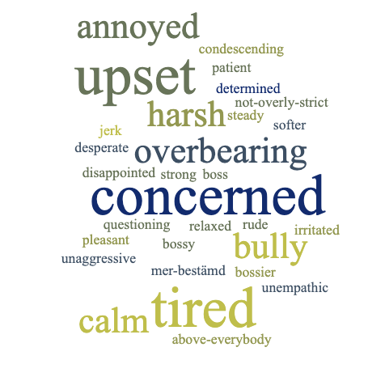
Adjectives used in decriptions of Robin – female (N=xx)

Slide 8
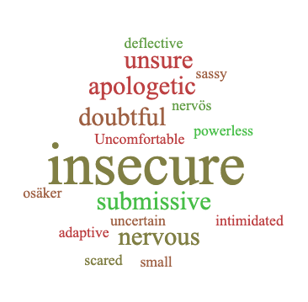
Adjectives used in decriptions of Kim - female

Slide 9
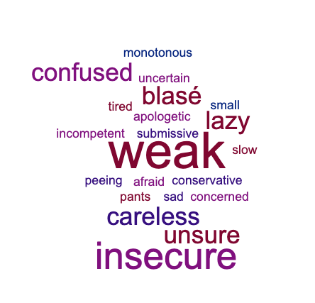
Adjectives used in decriptions of Kim - male

Slide 10
Summary impressions

Slide 11
Male-Female values (negative values M<F; Positive values M>F)

Slide 12
To discuss in groups
General thoughts about the results?
Why these patterns?
How do you think this ’knowledge is applicable to your profession?

